Slide 1
Semantic segmentation for autonomous driving
By : ABID Mohanned
BEJAOUI Bedis
TLILI Ahmed
Coach : Mr TLILI Fethi

Slide 2
Problem
01
02
Technology stack
TABLE OF CONTENTS
Data
03
04
Architecture: U-NET
05
Model Benchmarks
06
Model Results
07
conclusion

Slide 3
01
Problem

Slide 4
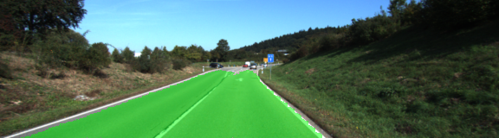
The objective of this project is to develop deep learning algorithms to understand the environment of an autonomous vehicle and allow it to navigate safely.

Slide 5
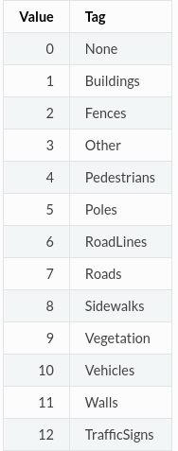
All classes and their labels

Slide 6
02
Technology stack

Slide 7



Technologies used

Slide 8
03
Data

Slide 9
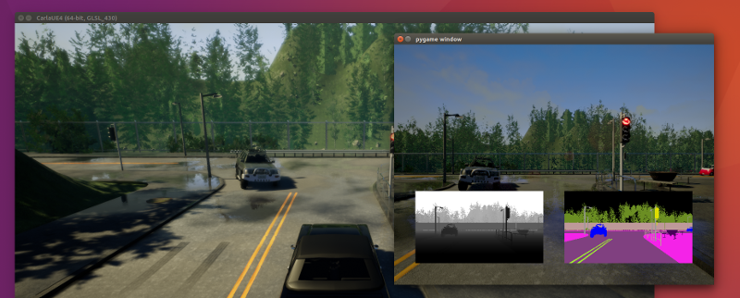
Data
Carla
To generate learning data and carry out autonomous driving tests, we used the CARLA driving simulator

Slide 10
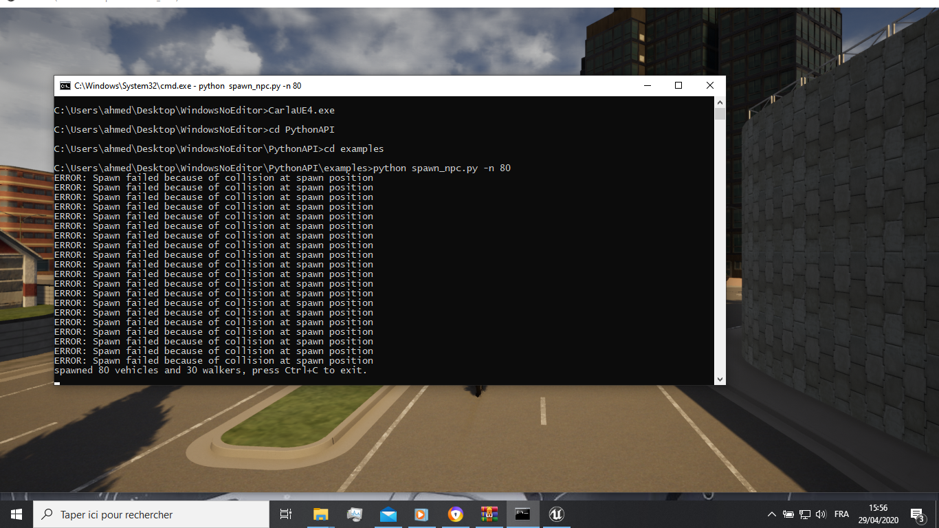
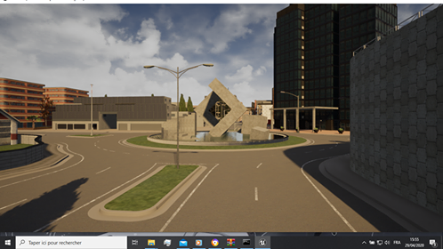
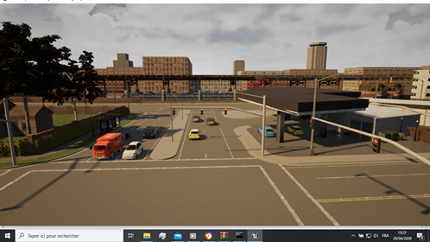
Adding vehicles and pedestrians
Empty Road
Instructions to add vehicles and pedestrians
Road filled with vehicles

Slide 11
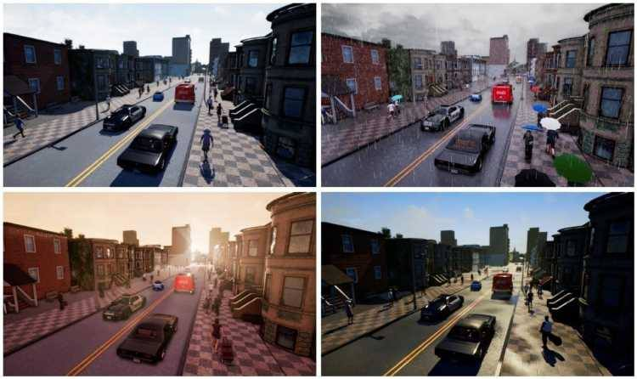
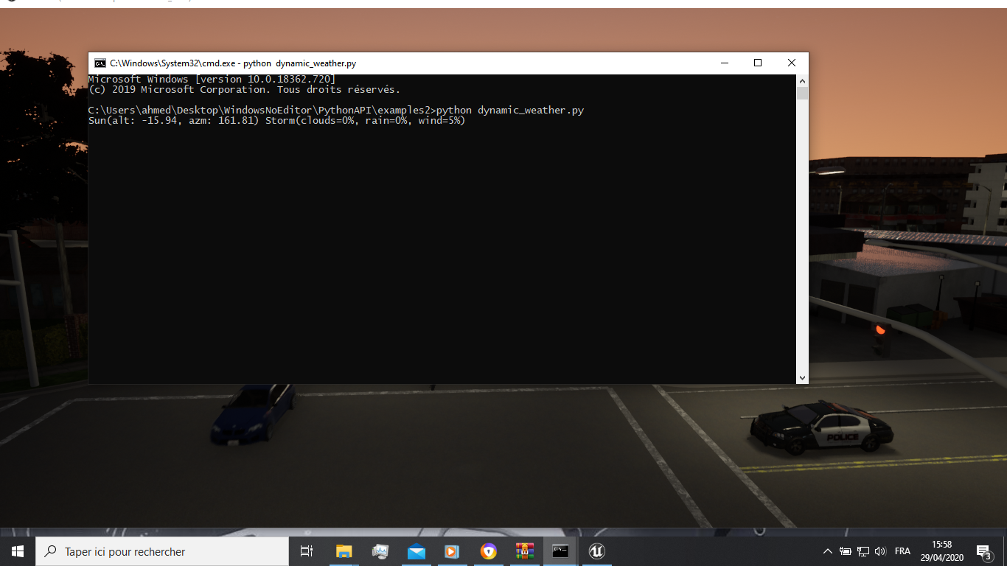
The Weather
This instruction generate a dynamic weather

Slide 12
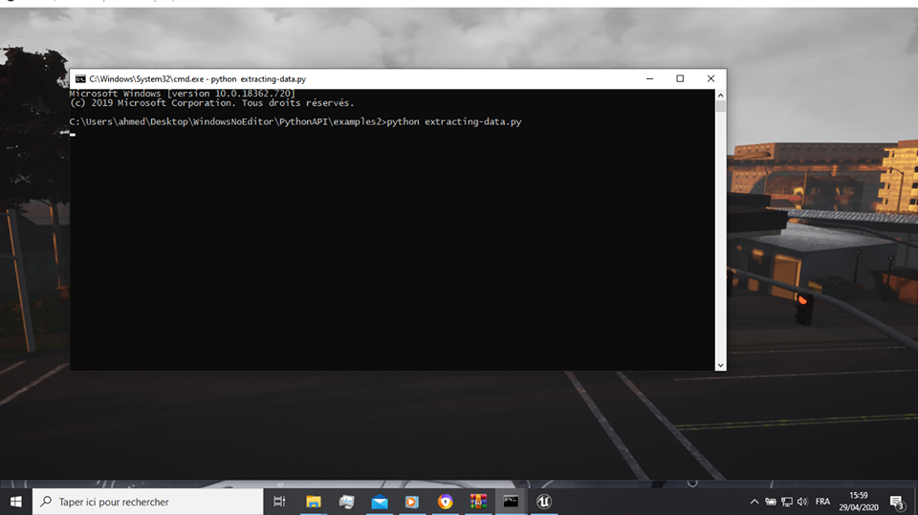
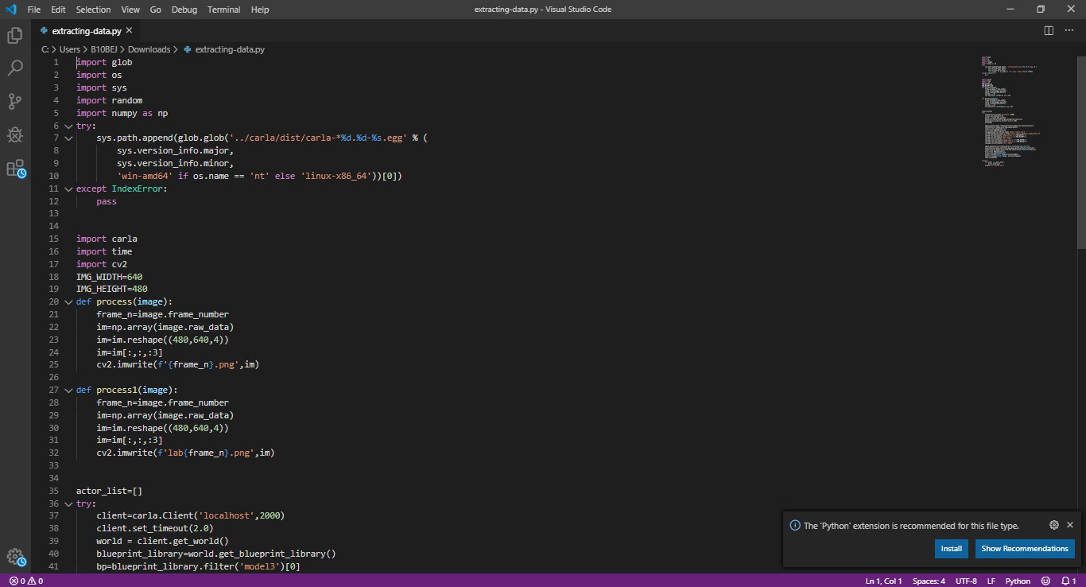
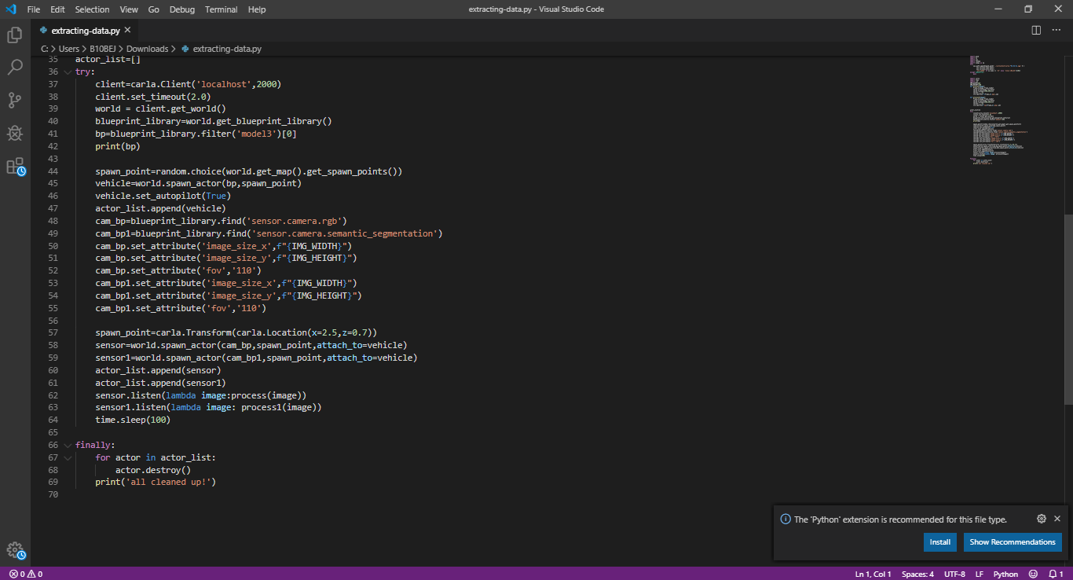
Generate and export our Data
Instruction and python script

Slide 13
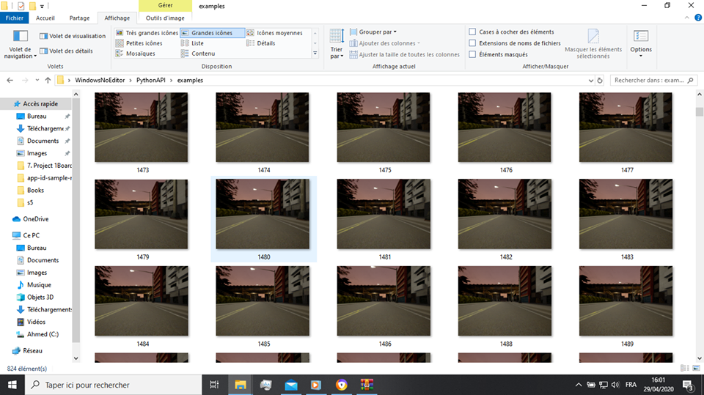
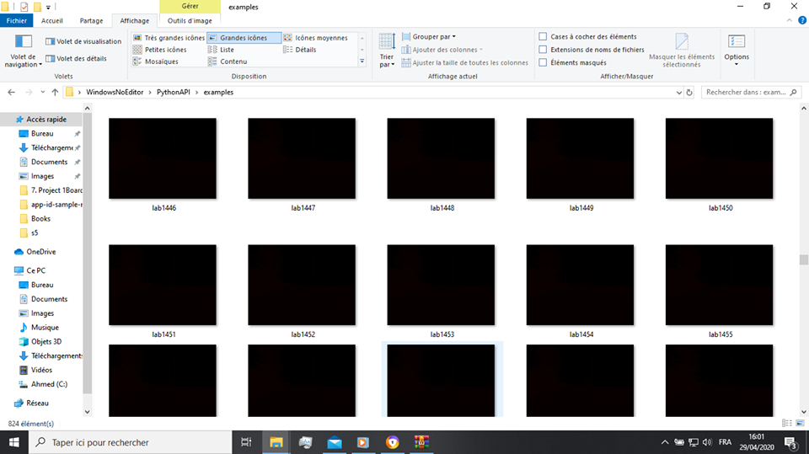
Dataset
Images
Labels

Slide 14
Data Partitioning
80%
Training
10%
Validation
10%
Test

Slide 15
04
Model architecture

Slide 16
U-NET Architecture
U-Net is a convolutional neural network that was developed for biomedical image segmentation at the Computer Science Department of the University of Freiburg
he network is based on the fully convolutional network and its architecture was modified and extended to work with fewer training images and to yield more precise segmentations

Slide 17


Slide 18
05
Model benchmarks

Slide 19
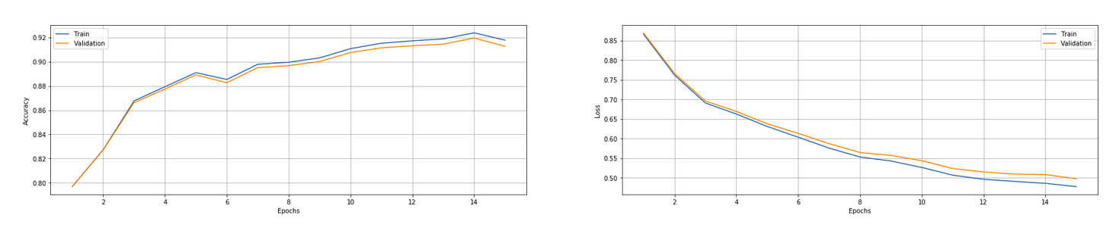
Model benchmarks
training_time=4hours
Epochs=15 batch_size=16
img_size=224
learning_rate=0.001

Slide 20
06
Model results

Slide 21
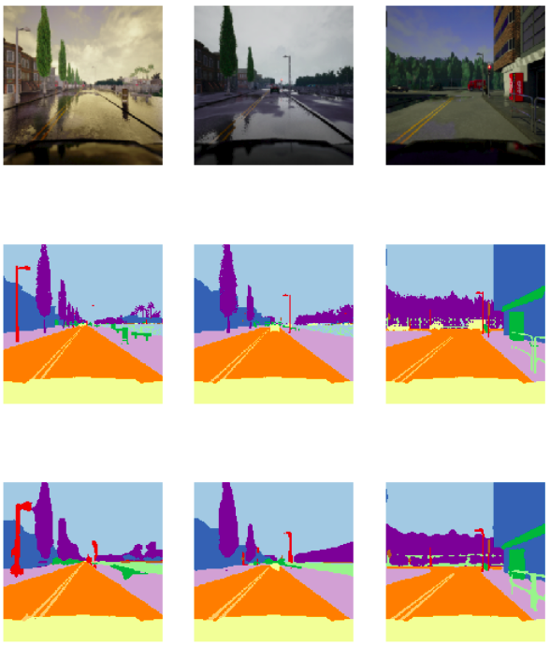
Model results
RGB IMAGES GROUND TRUTH IMAGES PREDICTED IMAGES

Slide 22
07
CONCLUSION

Slide 23
CONCLUSION
Our version of U-NET managed to achieve good results on our test set with an accuracy of 92% but with low resolution (224,224) due to lack of computional resources
You can find the source code here:
https://github.com/mohaned-abid/segmentation-for-autonomous-driving

